Slide 1
Data Mining
Ch 8/9: Classification – 2
Bayesian Classification Methods
Wan D. Bae, Ph.D.
baewd@hanyang.ac.kr

Slide 2
Overview
Classification: basic concepts
Classification methods:
  Decision tree induction
  Bayesian classification methods
  Neural networks
  Rule-based classification
Classification accuracy

Slide 3
Bayesian Classification
A statistical classifier: performs probabilistic prediction, i.e., predicts class membership probabilities
Foundation: Based on Bayes’ Theorem
Performance: A simple Bayesian classifier, naïve Bayesian classifier, has comparable performance with decision tree and selected neural network classifiers
Incremental: Each training example can incrementally increase/decrease the probability that a hypothesis is correct — prior knowledge can be combined with observed data
Standard: Even when Bayesian methods are computationally intractable, they can provide a standard of optimal decision making against which other methods can be measured

Slide 4
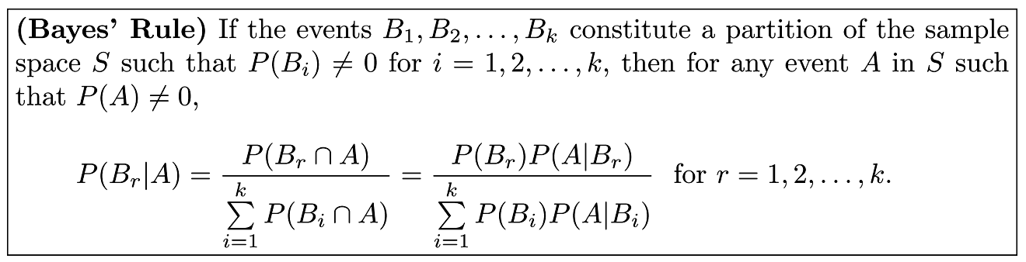
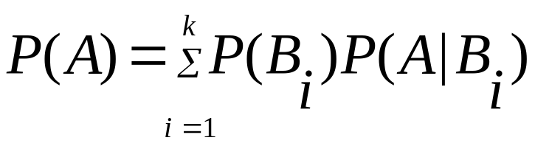
Bayes’ Rule
Total probability Theorem:

Slide 5
Bayes’ Rule Simple Example
(Diagnostics of lung Cancer)
A medical team at a hospital has developed a new test to diagnose lung cancer for the people living in Korea. They recently found the following outcomes:
The probability that a person living in Korea is a lung cancer patient: 0.02
The probability that a person who has lung cancer takes the test and he/she is diagnosed with lung cancer: 0.78
The probability that a person who doesn’t have lung cancer takes the test and he/she is diagnosed with lung cancer by the test: 0.06
Q1: What is the probability that a person takes the test and the test result is positive (diagnostic of lung cancer)
Q2: What is the probability that a person who is diagnosed with lung cancer actually has lung cancer?

Slide 6
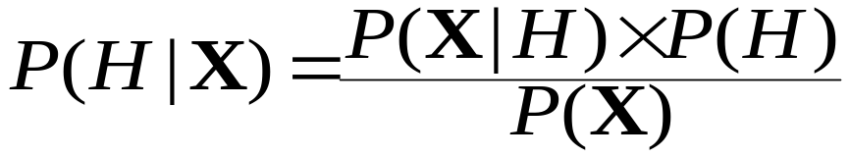
Bayesian Theorem: Basics
Let X be a data sample (evidence) whose class label is unknown
Let H be a hypothesis that X belongs to class C
Classification is to determine P(H|X),
  posteriori probability of H conditioned on X: the probability that the hypothesis holds given the observed data sample X.
  P(H|X) follows the Bayes theorem:
  P(H) (prior probability of hypothesis H): the initial probability that any given tuple will belong to class C before we observe any data
  E.g., X will buy computer, regardless of age, income, etc.
  P(X): probability that sample data is observed
  P(X|H) (likelihood): probability of observing the sample X, given that the hypothesis holds
  E.g., Given that X will buy computer, the probability that X is medium income

Slide 7
Prediction Based on Bayes’ Theorem
Given training data X, posteriori probability of a hypothesis H:
Informally, this can be viewed as
  posteriori = ( likelihood x prior ) / evidence
Predicts X belongs to C_{i} iff the probability P(C_{i} | X) is the highest among all the P(C_{k}|X) for all the k classes
Practical difficulty: It requires initial knowledge of many probabilities, involving significant computational cost

Slide 8
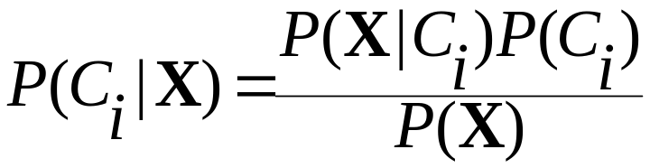
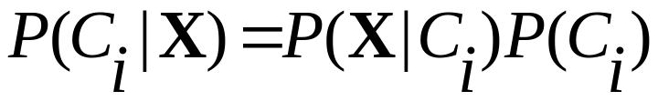
Driving the Maximum Posteriori
Let D be a training set of tuples and their associated class labels, and each tuple is represented by an n-D attribute vector X = (x₁, x₂, …, x_{n})
Suppose there are m classes C₁, C₂, …, C_{m}.
Classification is to derive the maximum posteriori, i.e., the maximal P(C_{i}|X) drived from Bayes’ theorem
Since P(X) is constant for all classes, only
  needs to be maximized

Slide 9
Bayes’ Rule to a Classification
None overlap→independent
C₂
C₃
C₄
C₁
p(A∩
C)
p(C
|
A)p(A)
p(C
|
A)
=
=
p(C)
p(C)
A
C₆
C₅
p(X
|
C
)p(C
)
p(X
|
C
)p(C
)
p(C
|
X)
=
i
i
=
i
i
i
k
p(X)
∑
p(X
|
C
)p(C
)
)
j
j
j = 1
Based on definition of conditional probability
p(C_{i}|X) is posterior probability given evidence X
p(C_{i}) is the prior probability
P(X|C_{i}) is the likelihood of the evidence given X
p(X) is the preposterior probability of the evidence

Slide 10

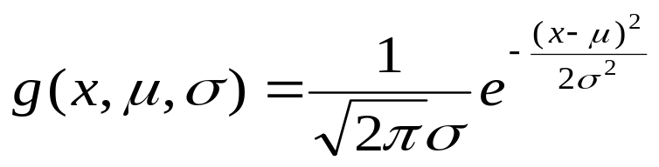

Naïve Bayes Classifier
A simplified assumption: attributes are conditionally independent (i.e., no dependence relation between attributes):
  This greatly reduces the computation cost: Only counts the class distribution
If Attribute k is categorical, P(x_{k}|C_{i}) is the # of tuples in C_{i} having value x_{k} divided by # of tuples of C_{i} in D ( |Ci, D| )
If Attribute k is continuous-valued, P(x_{k}|C_{i}) is usually computed based on Gaussian distribution with a mean μ and standard deviation σ :
  and P(x_{k}|C_{i}) is

Slide 11
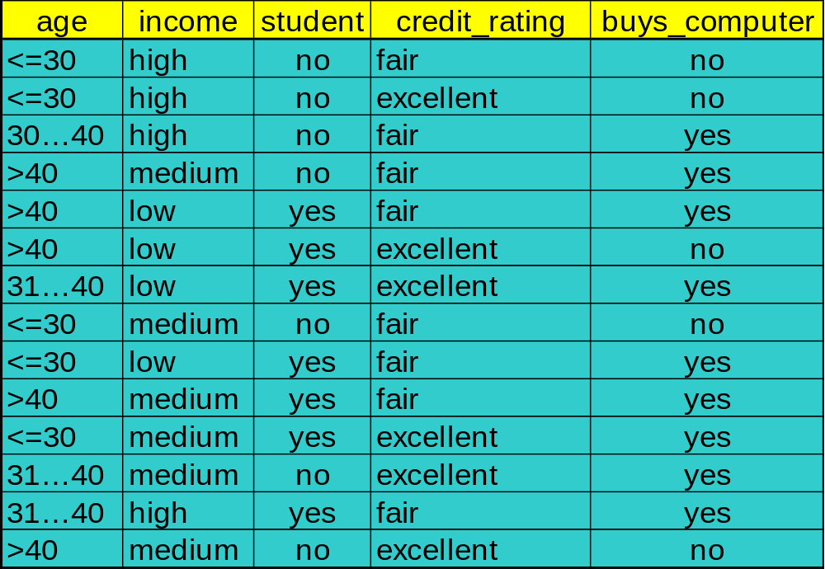
Training dataset
Class C1:buys_computer=‘yes’
C2:buys_computer=‘no’
Data sample: We want to predict its class label
X =(age<=30, Income=medium, Student=yes Credit_rating= Fair)
Training dataset

Slide 12
Naïve Bayesian Classifier: Example
Maximize
P(Ci): P(buys_computer = “yes”) =
P(buys_computer = “no”) =
Compute P(X|Ci) for each class:
P(age=“<30” | buys_computer=“yes”) =
P(income=“medium” | buys_computer=“yes”)=
P(student=“yes” | buys_computer=“yes)=
P(credit_rating=“fair” | buys_computer=“yes”)=
P(age=“<30” | buys_computer=“no”) =
P(income=“medium” | buys_computer=“no”) =
P(student=“yes” | buys_computer=“no”)=
P(credit_rating=“fair” | buys_computer=“no”)=
X=(age<=30 ,income =medium, student=yes,credit_rating=fair)
P(X|Ci) : P(X|buys_computer=“yes”)=
P(X|buys_computer=“no”)=
P(X|Ci)*P(Ci ) : P(X|buys_computer=“yes”) * P(buys_computer=“yes”)=
P(X|buys_computer=“no”) * P(buys_computer=“no”)=
Hence, X belongs to class “buys_computer=yes”
9/14=0.643
5/14=0.357
2/9=0.222
4/9=0.444
6/9=0.667
6/9=0.667
3/5=0.6
2/5=0.4
1/5=0.2
2/5=0.4
0.222 x 0.444 x 0.667 x 0.0.667 =0.044
0.6 x 0.4 x 0.2 x 0.4 =0.019
0.028
0.007

Slide 13

Avoiding the Zero-Probability Problem
Naïve Bayesian prediction requires each conditional prob. be non-zero. Otherwise, the predicted probability will be zero
Ex. Suppose a dataset with 1000 tuples, income=low (0), income= medium (990), and income = high (10)
  Use Laplacian correction (or Laplacian estimator)
  Adding 1 to each case
    Prob(income = low) = 1/1003
    Prob(income = medium) = 991/1003
    Prob(income = high) = 11/1003
  The “corrected” probability estimates are close to their “uncorrected” counterparts

Slide 14
Naïve Bayesian Classifier: Comments
Advantages :
  Easy to implement
  Good results obtained in most of the cases
Disadvantages :
  Assumption: attributes conditional independence, therefore loss of accuracy
  Practically, dependencies exist among variables
    E.g., hospitals: patients: Profile: age, family history, etc.
  Symptoms: fever, cough etc., Disease: lung cancer, diabetes, etc.
  Dependencies among these cannot be modeled by Naïve Bayesian Classifier
How to deal with these dependencies?
  Bayesian Belief Networks (Bayesian Networks)

Slide 15
Bayesian Networks
Bayesian networks allows:
  A subset of the variables conditionally independent
  There are some independent variables
A (directed acyclic) graphical model of causal relationships
  Represents dependency among the variables
  Gives a specification of joint probability distribution
Nodes: random variables
Links: dependency
X and Y are the parents of Z, and Y is the parent of P
No dependency between Z and P
Has no loops or cycles
X
Y
Z
P

Slide 16
Definition of a Bayesian Network
Factored joint probability distribution as a directed graph
  structure for representing knowledge about uncertain variables
  computational architecture for computing the impact of evidence on beliefs
Knowledge structure:
  variables are depicted as nodes
  arcs represent probabilistic dependence between variables
  conditional probabilities encode the strength of the dependencies
Computational architecture:
  computes posterior probabilities given evidence about selected nodes
  exploits probabilistic independence for efficient computation

Slide 17
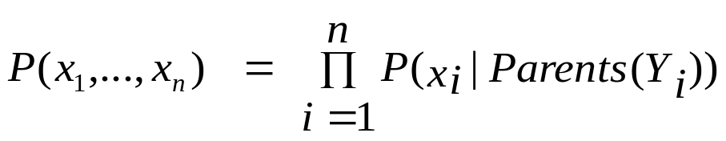
Bayesian Belief Network: An Example
Family
History (FH)
Smoker (S)
(FH, S)
(FH, ~S)
(~FH, S)
(~FH, ~S)
LC
0.8
0.5
0.7
0.1
~LC
0.2
0.5
0.3
0.9
LungCancer
(LC)
Emphysema
Conditional Probability Table
CPT for the variable LungCancer shows the conditional probability for each possible combination of its parents:
PositiveXRay
Dyspnea
Bayesian Belief Networks
Example:

Slide 18
Example from Medical Diagnostics
Visit to Asia
Smoking
Patient Information
Tuberculosis
Lung Cancer
Bronchitis
Medical Difficulties
Tuberculosis
or Cancer
XRay Result
Dyspnea
Diagnostic Tests
Network represents a knowledge structure that models the relationship between medical difficulties, their causes and effects, patient information and diagnostic tests

Slide 19
Example from Medical Diagnostics
Tuber
Present
Present
Absent
Absent
Lung Can
Present
Absent
Present
Absent
Tub or Cancer
True
True
True
False
Visit to Asia
Smoking
Patient Information
Tuberculosis
Lung Cancer
Bronchitis
Dyspnea
Tub or Cancer
True
True
False
False
Bronchitis
Present
Absent
Present
Absent
Medical Difficulties
Present
0.90
0.70
0.80
0.10
Absent
0.l0
0.30
0.20
0.90
Tuberculosis
or Cancer
XRay Result
Dyspnea
Diagnostic Tests
Relationship knowledge is modeled by deterministic functions, logic and conditional probability distributions

Slide 20
Recall Bayes’ Rule
C₂
C₃
C₄
C₁
p(A∩
C)
p(C
|
A)p(A)
p(C
|
A)
=
=
p(C)
p(C)
A
C₆
C₅
p(X
|
C
)p(C
)
p(X
|
C
)p(C
)
p(C
|
X)
=
i
i
=
i
i
i
k
p(X)
∑
p(X
|
C
)p(C
)
)
j
j
j = 1
Based on definition of conditional probability
p(C_{i}|X) is posterior probability given evidence X
p(C_{i}) is the prior probability
P(X|C_{i}) is the likelihood of the evidence given X
p(X) is the preposterior probability of the evidence

Slide 21
Factored Joint Distribution Example
Directly dependent to parent(edge)
X₁
X₂
X₃
X₅
X₄
X₆
p(x₁, x₂, x₃, x₄, x₅, x₆) = p(x₆ | x₅) p(x₅ | x₃, x₂) p(x₄ | x₂, x₁) p(x₃ | x₁) p(x₂ | x₁) p(x₁)

Slide 22
Arc Reversal - Bayes Rule
X₁
X₂
X₁
X₂
X₃
X₃
p(x₁, x₂, x₃) = p(x₃ | x₁) p(x₂ | x₁) p(x₁)
p(x₁, x₂, x₃) = p(x₃ | x₂, x₁) p(x₂) p( x₁)
is equivalent to
is equivalent to
X₁
X₂
X₁
X₂
X₃
X₃
p(x₁, x₂, x₃) = p(x₃ | x₁) p(x₂ , x₁)
= p(x₃ | x₁) p(x₁ | x₂) p( x₂)
p(x₁, x₂, x₃) = p(x₃, x₂ | x₁) p( x₁)
= p(x₂ | x₃, x₁) p(x₃ | x₁) p( x₁)

Slide 23
Inference Using Bayes Theorem
Tuber-
culosis
Lung
Cancer
Bronchitis
Lung
Cancer
Bronchitis
Tuberculosis
or Cancer
Tuberculosis
or Cancer
Dyspnea
Dyspnea
Lung
Cancer
Lung
Cancer
Lung
Cancer
Tuberculosis
or Cancer
Dyspnea
Dyspnea
Dyspnea
The general probabilistic inference problem is to find the probability of an event given a set of evidence
This can be done in Bayesian nets with sequential applications of Bayes Theorem

Slide 24
Why Not this Straightforward Approach?
Entire network must be considered to determine next node to remove
Impact of evidence available only for single node, impact on eliminated nodes is unavailable
Spurious dependencies between variables normally perceived to be independent are created and calculated
Algorithm is inherently sequential, unsupervised parallelism appears to hold most promise for building viable models of human reasoning
In 1986 Judea Pearl published an innovative algorithm for performing inference in Bayesian nets that overcomes these difficulties

Slide 25
Propagation Algorithm Objective
Data
Data
The algorithm’s purpose is “… fusing and propagating the impact of new evidence and beliefs through Bayesian networks so that each proposition eventually will be assigned a certainty measure consistent with the axioms of probability theory.” (Pearl, 1988, p 143)

Slide 26
Training Bayesian Networks: Several Scenarios
Case 1: Given both the network structure and all variables observable: compute only the CPT entries
Case 2: Network structure known, some variables hidden: gradient descent (greedy hill-climbing) method, i.e., search for a solution along the steepest descent of a criterion function
  Weights are initialized to random probability values
  At each iteration, it moves towards what appears to be the best solution at the moment, i.e., backtracking
  Weights are updated at each iteration & converge to local optimum
Case 3: Network structure unknown, all variables observable: search through the model space to reconstruct network topology
Case 4: Unknown structure, all hidden variables: No good algorithms known for this purpose
D. Heckerman. A Tutorial on Learning with Bayesian Networks. In Learning in Graphical Models, M. Jordan, ed.. MIT Press, 1999.

Slide 27
Applications
Industrial
  Processor Fault Diagnosis - by Intel
  Auxiliary Turbine Diagnosis - GEMS by GE
  Diagnosis of space shuttle propulsion systems - VISTA by NASA/Rockwell
  Situation assessment for nuclear power plant - NRC
Military
  Automatic Target Recognition - MITRE
  Autonomous control of unmanned underwater vehicle - Lockheed Martin
  Assessment of Intent
Medical Diagnosis
  Internal Medicine
  Pathology diagnosis - Intellipath by Chapman & Hall
  Breast Cancer Manager with Intellipath
Commercial
  Financial Market Analysis
  Information Retrieval
  Software troubleshooting and advice - Windows 95 & Office 97
  Pregnancy and Child Care - Microsoft
  Software debugging - American Airlines’ SABRE online reservation system

Slide 28
Software
Many software packages available
Netica
  www.norsys.com
  Very easy to use
  Implements learning of probabilities
Hugin
  www.hugin.dk
  Good user interface
  Implements continuous variables
Belief net site
  http://bayes.stat.washington.edu/almond/belief.html
GeNIe and SMILE
  http://www2.sis.pitt.edu/~genie
  C++ and graphics packages

Slide 29

Ipython Notebook
IPython notebook will be used for some exercises to learn data mining techniques
  Install the Jupyter Notebook using Anaconda and conda
  http://jupyter.org/install.html
  Information about Jupyter Notebook:
  https://ipython.org/notebook.html
Notes:
3

